Slide 1
Healthcare Data Breaches
Srinivas Pallapu 11604461

Slide 2
Data Collection

Slide 3
Data Dictionary

Slide 4
Data Preprocessing

Slide 5
Exploratory Data Analysis-EDA

Slide 6
Research questions:

Slide 7
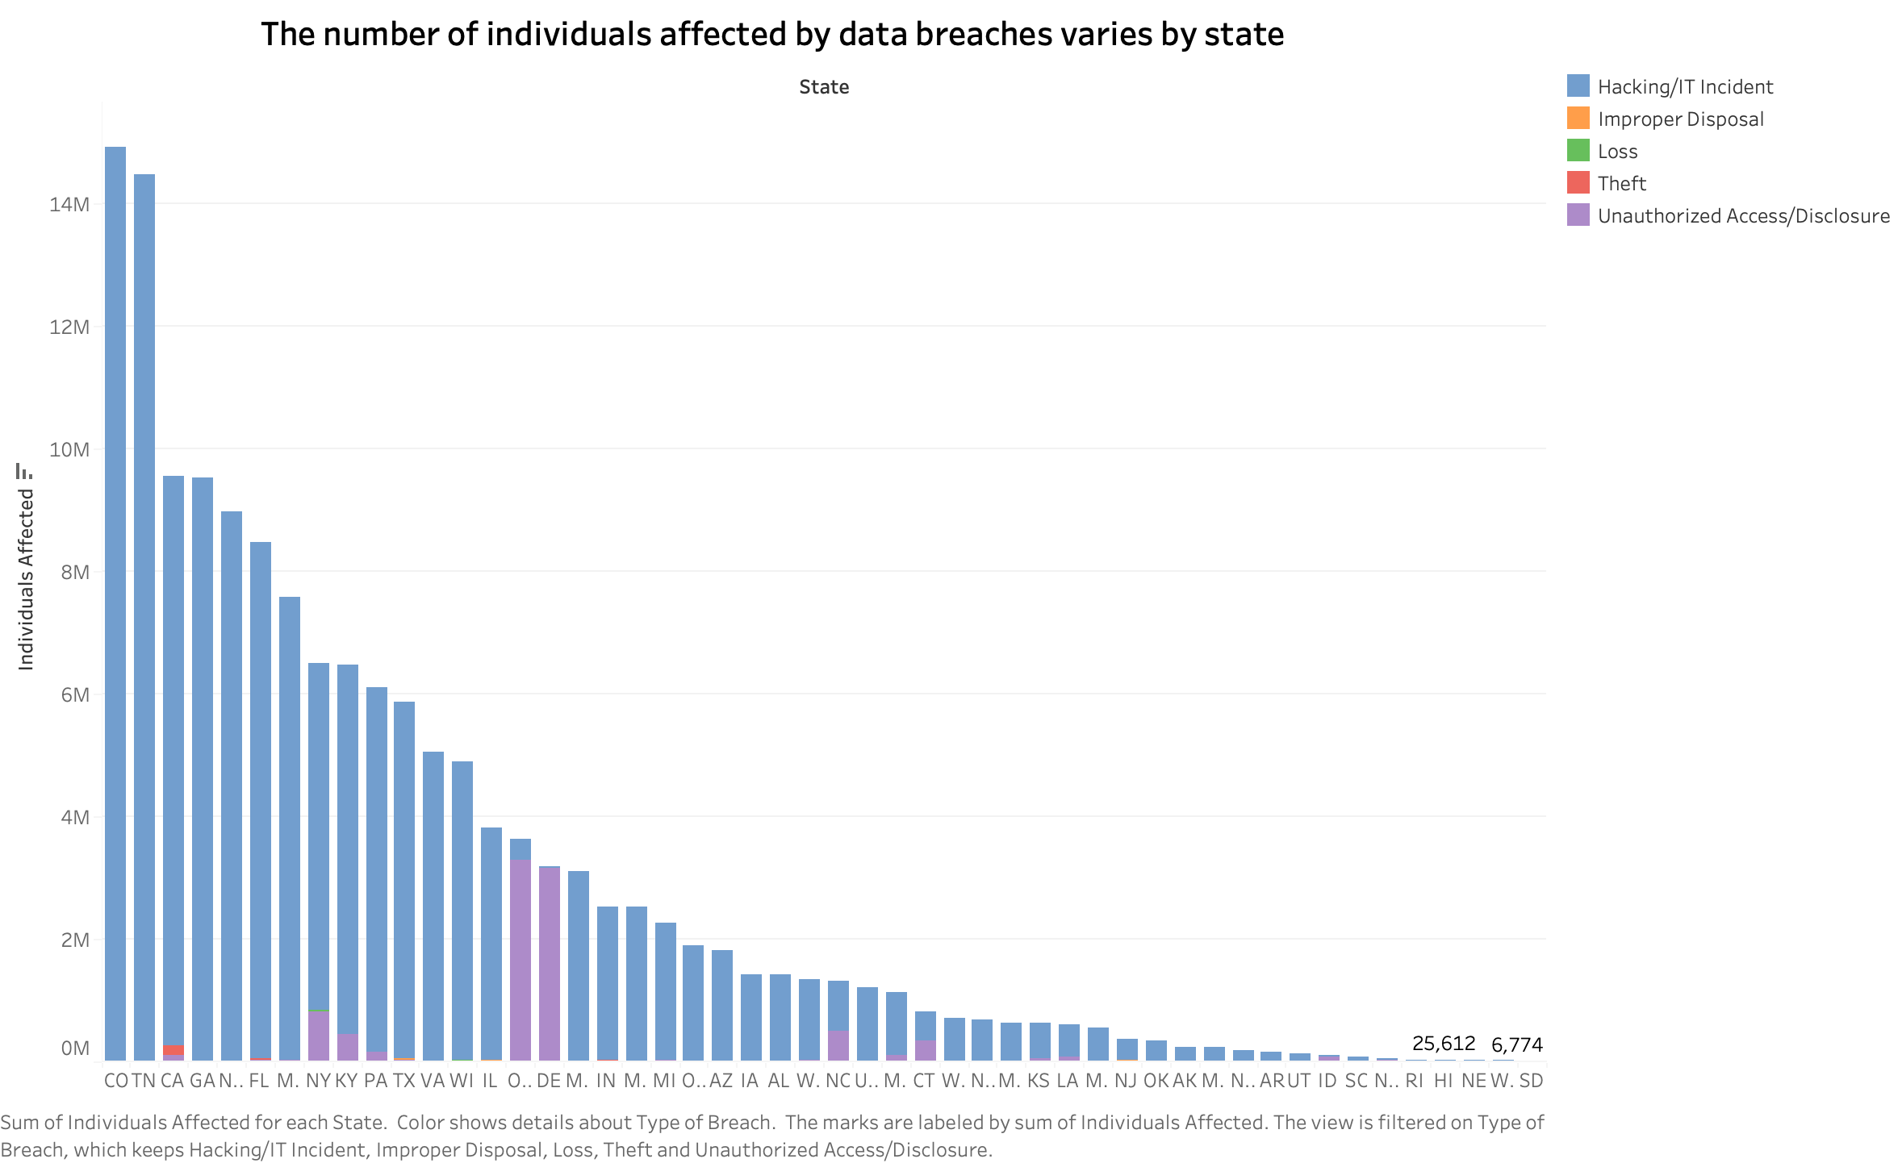
Visualizations

Slide 8
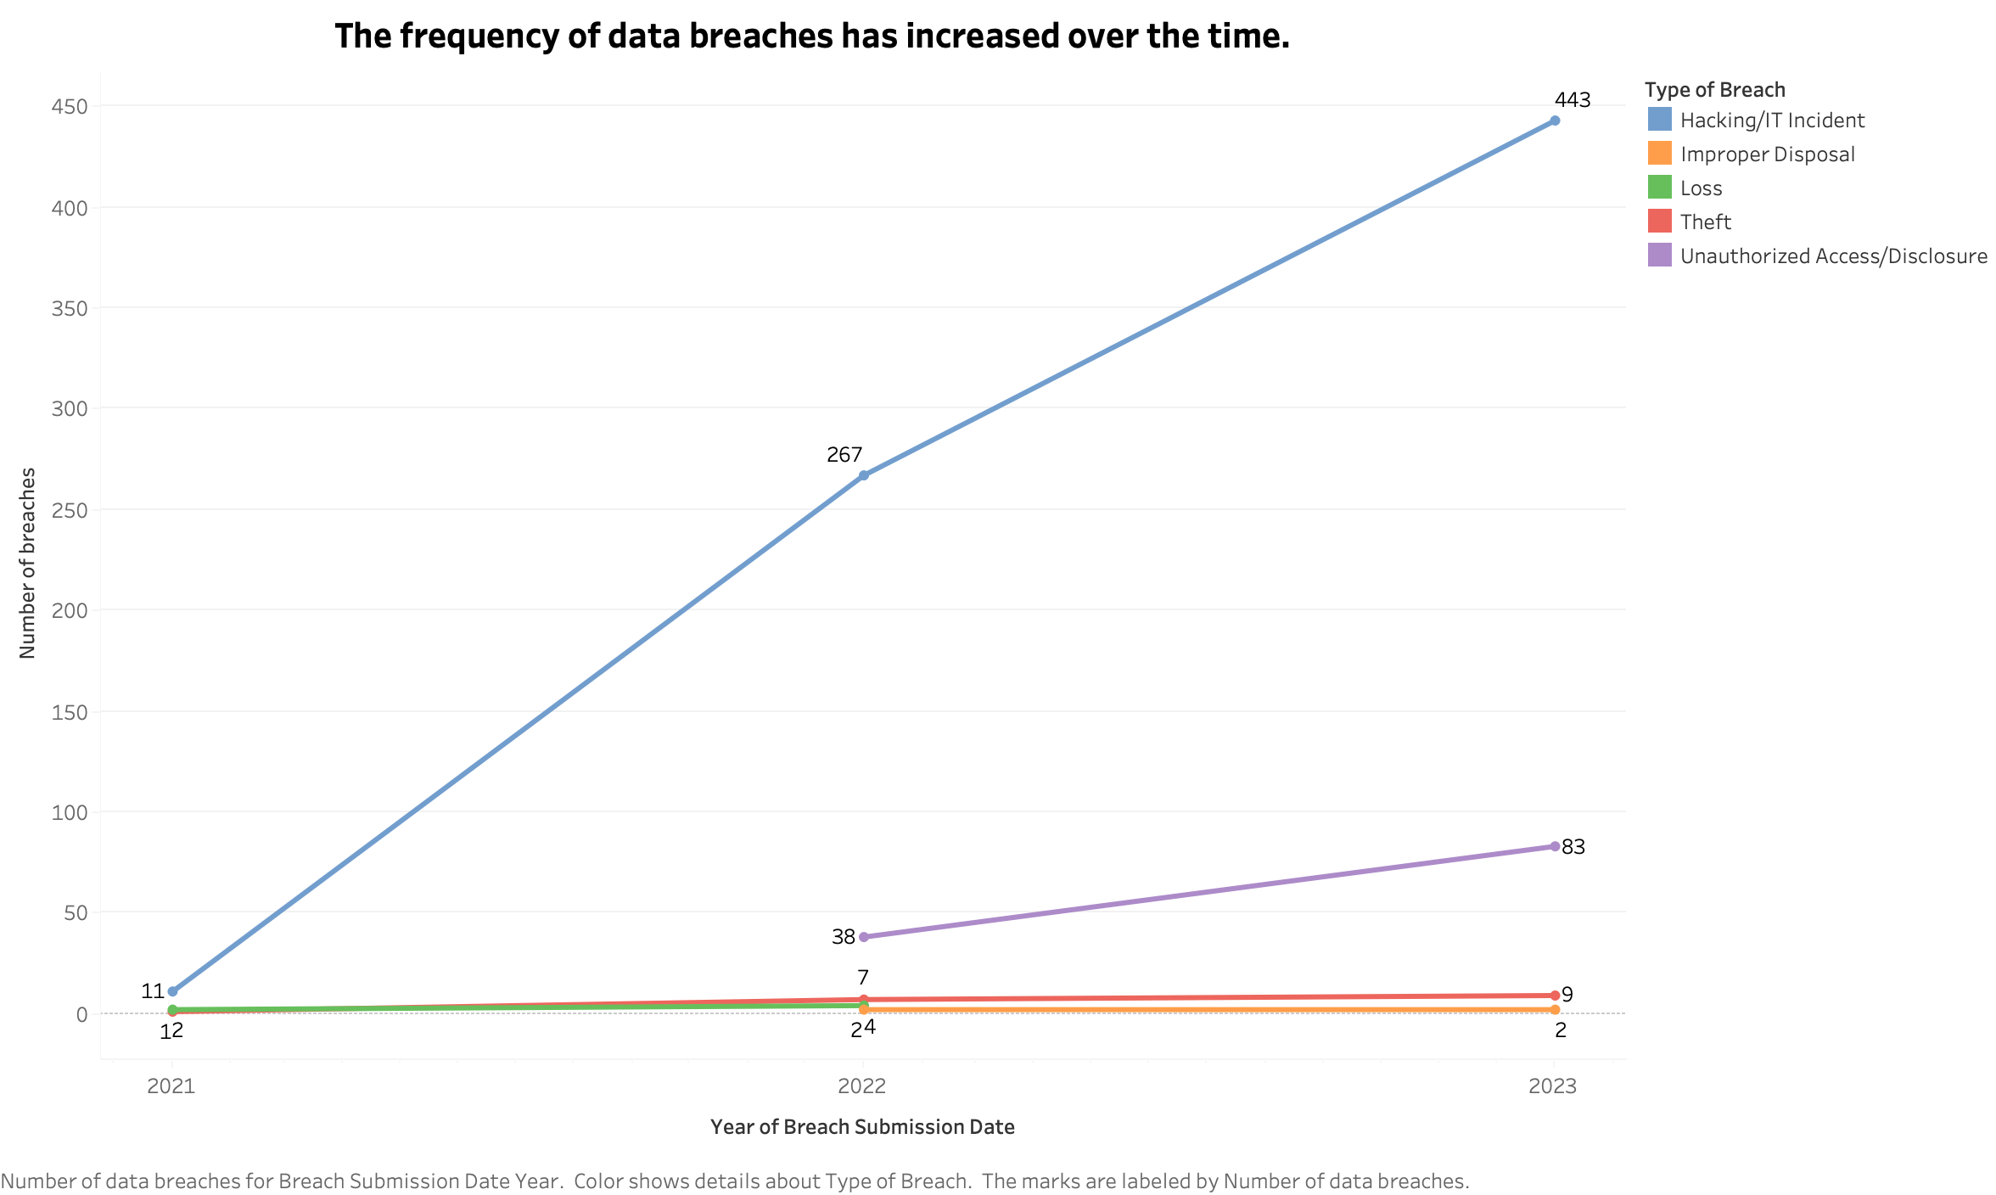

Slide 9
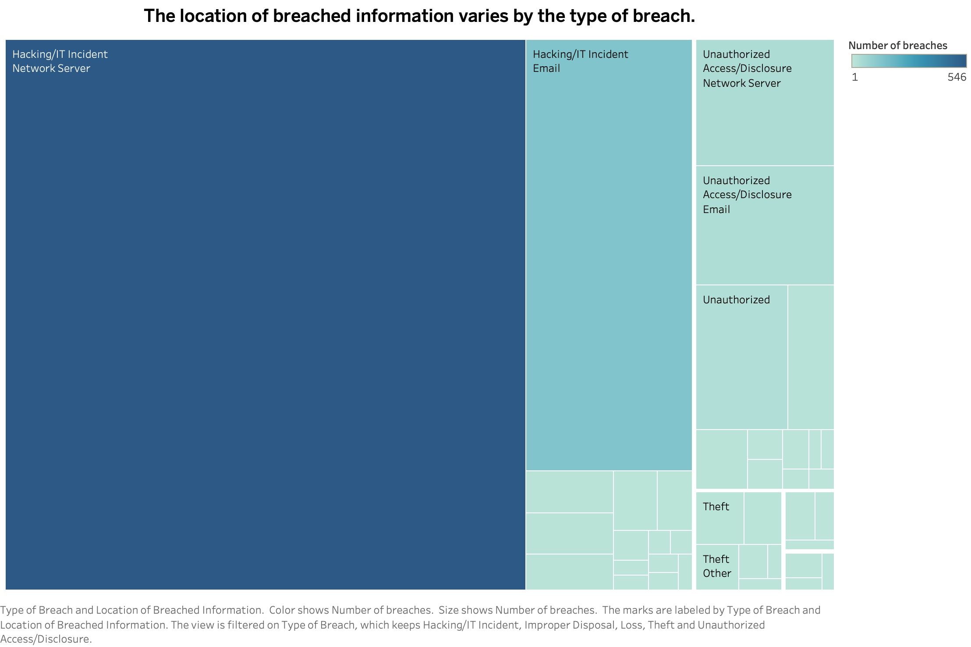

Slide 10
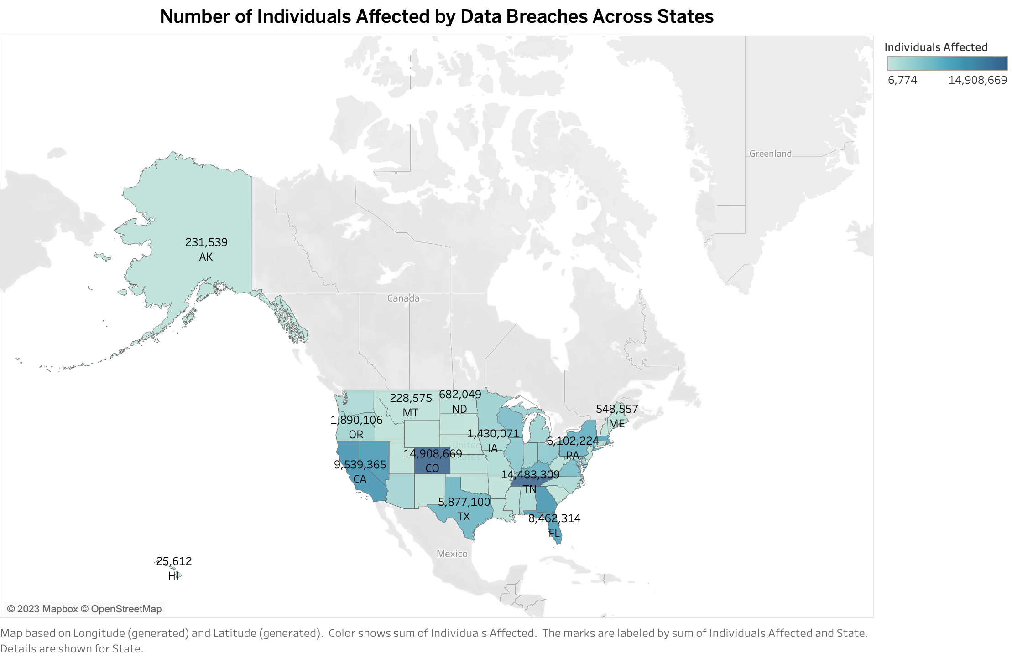

Slide 11
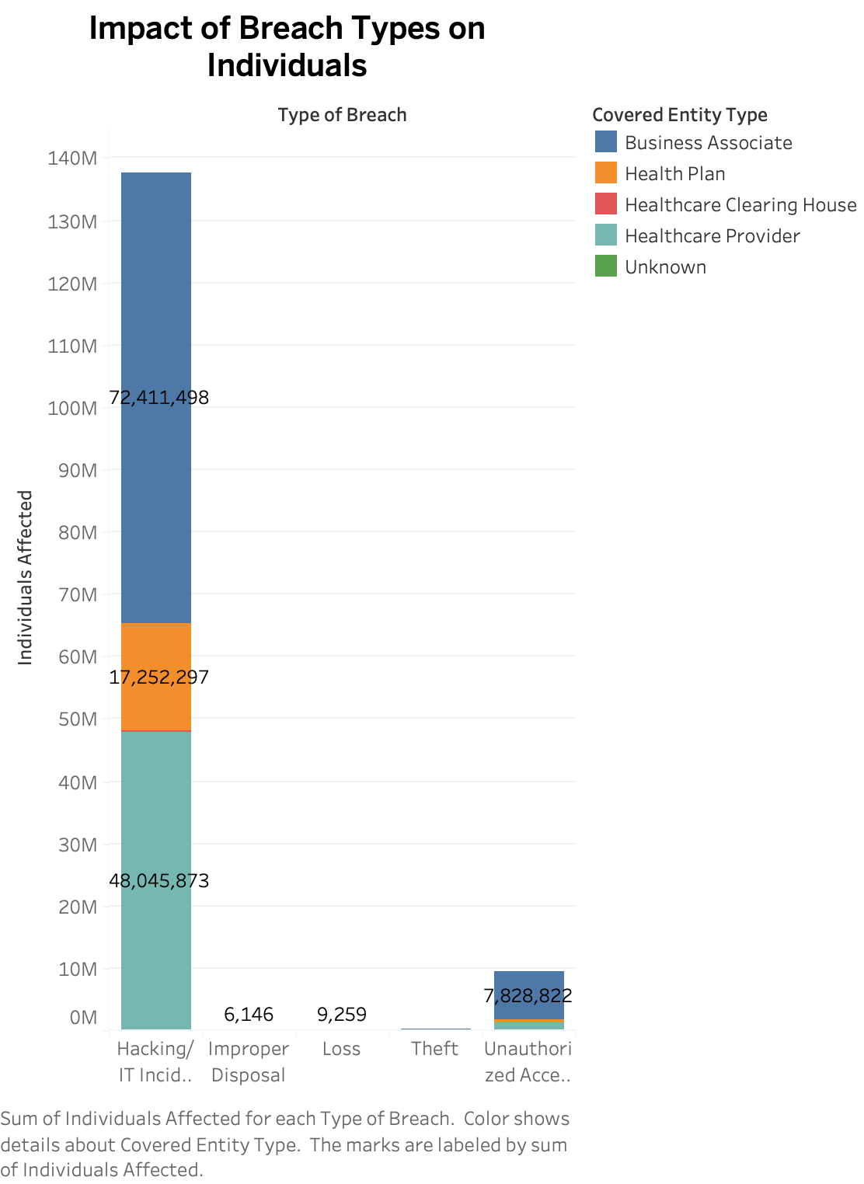

Slide 12
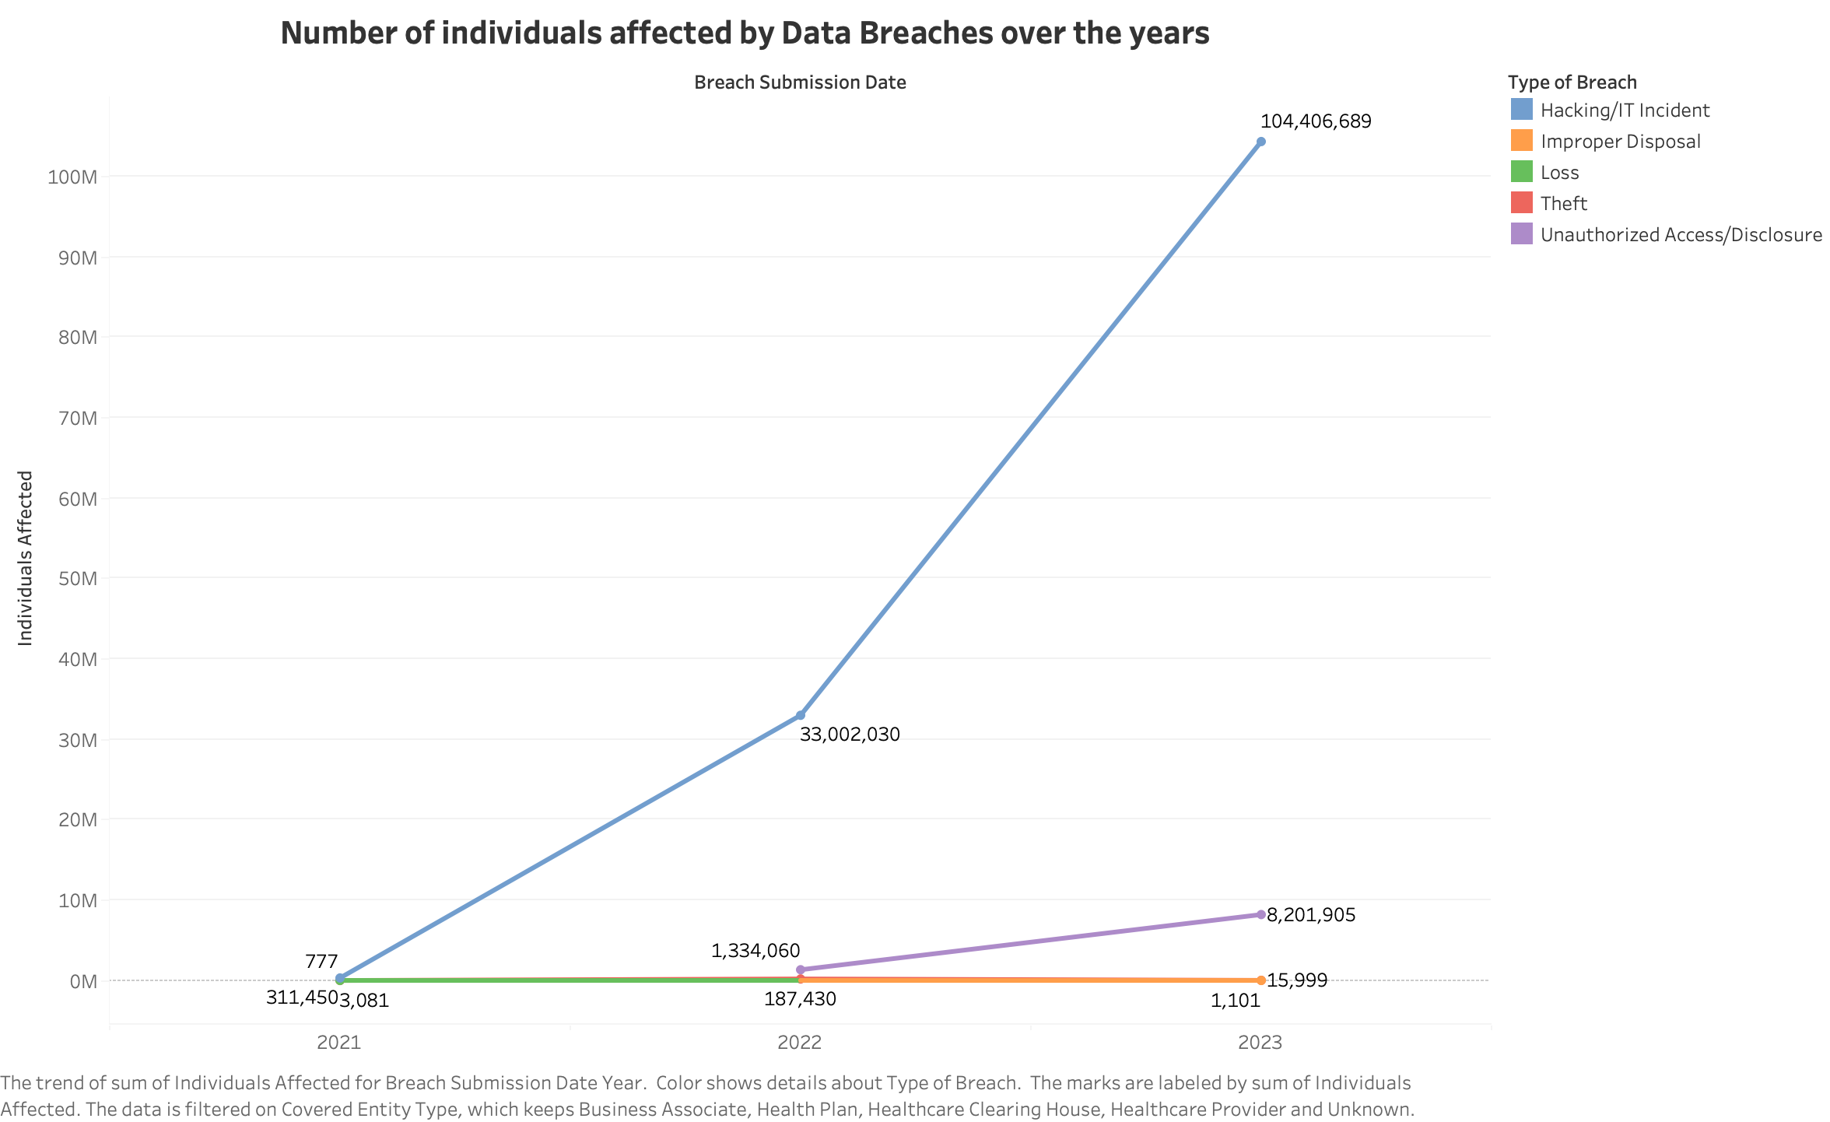

Slide 13
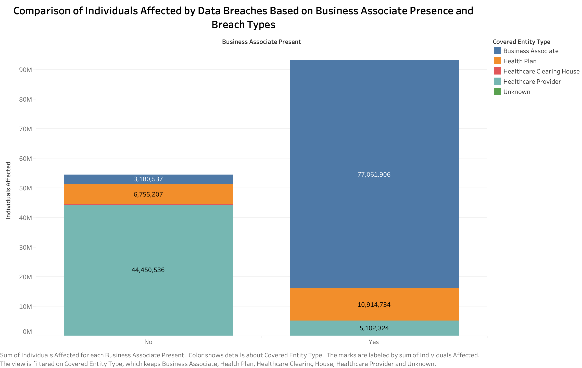

Slide 14
